Slide 1
ANALYTICS CASE STUDY · OPERATIONS
Supply chain
analysis
THE READ
THE STARTING POINT
From a 100-row dataset to decisions on demand, inventory, quality, and logistics.
Sales signals meet operational action.
100 rows · 24 columns · no missing data
Notes:
This case study follows the path from a compact dataset to operational recommendations across demand, inventory, suppliers, transportation, and inspection quality.

Slide 2
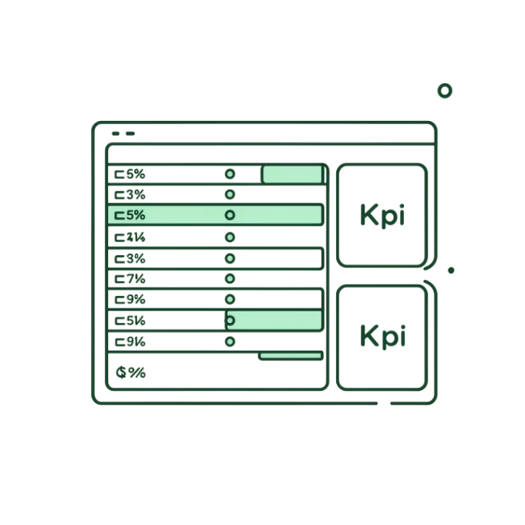
01 / THE QUESTION
A 100-row dataset became an operational decision tool
The work started with one question: where are sales, inventory, supplier quality, and logistics performance creating avoidable risk?
APPROACH
DATASET
Clean and explore the data, answer business questions in SQL, then bring the story to life in Power BI.
100
rows · 24 columns · no missing data
RAW DATA → DECISION VIEW
Notes:
Frame the project as a translation exercise. The dataset was small, but the analysis made it useful for operational decisions.

Slide 3





02 / THE OPERATING PICTURE
The analysis connects five operational levers
Each lever answers a different operating question, then the five views combine into one decision picture.
01 / SALES
02 / INVENTORY
03 / SUPPLIERS
Sales performance
Stock risk
Supplier performance
Revenue by product category.
Inventory levels and products at risk of stockout.
Manufacturing cost and defect rate.
04 / TRANSPORT
05 / QUALITY
Transportation efficiency
Inspection outcomes
Modes, routes, cost, and delivery signals.
Inspection results and customer / market patterns.
Notes:
These are the five lenses used throughout the analysis. The important move is connecting them rather than treating each metric as a separate report.

Slide 4
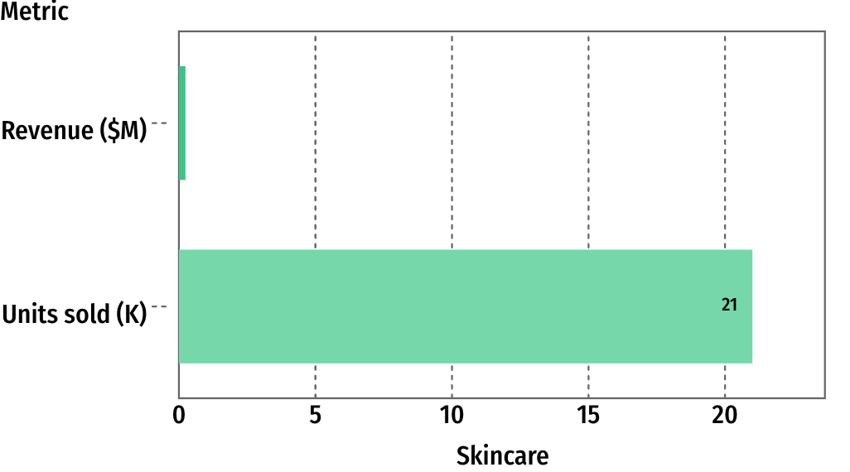

REVENUE AND UNITS SOLD BY PRODUCT TYPE
03 / DEMAND SIGNAL
Skincare is the growth anchor
41.5%
of total revenue
21K units sold, or 45% of total units.
USE THE CATEGORY MIX TO GUIDE ASSORTMENT, REPLENISHMENT, AND PROMOTIONAL FOCUS.
Notes:
Skincare leads both revenue and unit volume. That makes it the clearest anchor for assortment, replenishment, and promotional focus.

Slide 5
04 / INVENTORY DECISIONS
Inventory decisions should follow demand, not averages
The useful question is not whether inventory looks normal. It is which products are selling while stock is low.
CHECK
PRIORITIZE
REPLENISH
Find exposure
Follow demand
Combine signals
Identify products with low or zero stock levels before they become missed-sales events.
Prioritize products that sell well while carrying low inventory.
Use product type, SKU sales, and remaining stock together to guide replenishment.
Notes:
Average inventory can hide the products that matter most. Replenishment should combine demand and remaining stock at the product and SKU level.

Slide 6

05 / LOGISTICS SIGNAL
MODE READOUT
Road transit is the logistics bottleneck
Road
Highest defect rate at approximately 78.
Sea freight
Identified as the most cost-effective and reliable mode.
Action
Audit road providers and shift viable high-volume shipments toward sea or rail.
ROAD
≈78
highest defect rate
Notes:
Road is the outlier in the logistics view. The recommendation is targeted: audit road providers, then move viable high-volume shipments toward sea or rail.

Slide 7
06 / QUALITY CONTROL
Route A is the clearest quality-control intervention
Route-level inspection results make the next investigation specific rather than broad.
INTERVENE
SIGNAL
INVESTIGATE
Join the decisions
Route A stands out
Trace the failure
Route A records the highest count of failed inspections.
Investigate handling protocols, bottlenecks, and failure patterns on the route.
Pair route-level inspection results with carrier and transportation-mode decisions.
Notes:
Route A gives the quality conversation a concrete starting point. The next step is to connect its inspection failures to handling, carriers, and transport mode.

Slide 8

07 / DATA AND GEOGRAPHY
Two signals are easy to act on: data quality and geography
MARKETS
Mumbai and Kolkata generate the highest overall revenue.
CUSTOMER DATA
Operating move: Improve demographic capture while allocating inventory and promotions toward the strongest hubs.
29.97%
of revenue is attributed to unknown demographics.
Notes:
These signals are actionable without a new analytical model. Improve demographic capture, and use Mumbai and Kolkata as the strongest geographic cues for allocation and promotion.

Slide 9


08 / REPEATABLE WORKFLOW
Python
The workflow turns raw data into a repeatable analysis
Load, inspect, describe, and prepare the dataset.
The tools have distinct jobs: prepare the data, answer the questions, then make the findings usable.
SQL
Answer business questions through aggregation, filtering, grouping, and ranking.
Power BI
Translate the findings into KPI cards, comparisons, and interactive dashboard views.
Notes:
Keep the workflow simple in the story: Python prepares, SQL answers, and Power BI communicates. That separation makes the analysis repeatable and explainable.

Slide 10
01
Audit road transit providers and shift viable shipments to lower-risk modes.
09 / RECOMMENDATIONS
Four moves would improve the operating picture
The analysis ends with actions tied directly to the strongest signals in the data.
02
Investigate Route A failures and tighten handling controls.
03
Capture missing customer demographics through loyalty or incentive mechanics.
04
Expand inventory allocation and promotions in Mumbai and Kolkata while reviewing the Delhi strategy.
Notes:
Close by showing that the recommendations are operational, specific, and traceable to the analysis: logistics, quality, customer data, and market allocation.

